Slide 1

Introduction to MySQL

Slide 2
MySQL Roadmap
Week 1
Introduction MySQL
Architecture Overview
Datatypes
Creating/Dropping tables
Basic Syntax
SELECT
Filtering with WHERE
Sorting with ORDER BY
INSERT/UPDATE/DELETE
Database Transactions (EN Chapter 20)
Getting information about the database
Literal Strings
Lab 1

Slide 3
Introduction to MySQL
Relational database management system
World’s most popular open source database (2nd most widely used)
Founded by David Axmark, Allan Larsson and Michael Widenius
Sun Microsystems bought MySQL in 2008
Oracle acquired Sun in 2010
Big MySQL Community:
http://dev.mysql.com
http://mysql.com
http://twitter.com/mysql_community
http://planet.mysql.com

Slide 4
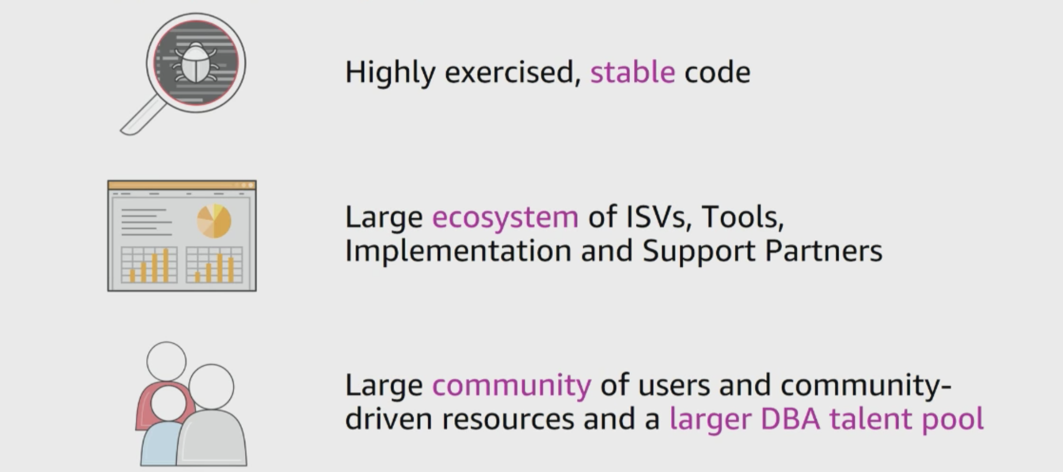
”Most popular” buys you..

Slide 5
Introduction to MySQL
MySQL uses Structured Query Language (SQL)
MySQL Database server is very fast and easy to use
Installation process can get complicated, as it depends on
Server OS
Environment
Database applications
Supports over twenty different platforms (cross-platform support as well)
Multiple storage engines
Written in C and C++
Used by Java, Python, PHP developers

Slide 6
Introduction to MySQL
Free and paid editions
Community Server, Enterprise and Cluster
MySQL software is Open Source
We can download it and modify it
Uses GNU General Public License

Slide 7

MySQL Customers

Slide 8
MySQL Options
You can run MySQL
On-premises
Self-managed on EC2
Amazon RDS

Slide 9
Why run managed MySQL in RDS
MySQL RDS – Amazon’s relational database service
Automatic failover
Backup & Recovery
Isolation & Security
Industry compliance
Automatic patching
Advanced monitoring
Push-button scaling (elastic volumes up to 32 TB)

Slide 10

Why run managed MySQL in RDS

Slide 11
Introduction to MySQL
MySQL RDS limitations
RDS does not grant users SUPER privilege
Some MySQL parameters require special considerations in RDS
Can’t access MySQL data directory and logs directly
Replication limitations
Less control over the database performance

Slide 12
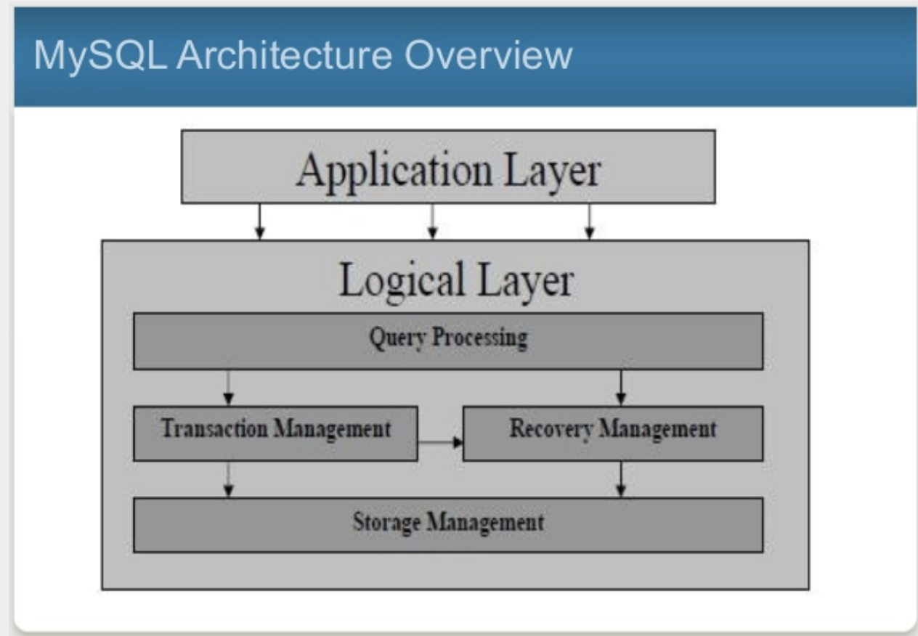
MySQL Architecture

Slide 13
MySQL Architecture – MySQL Server
Is a database server program (mysqld)
Manages access to database on disk and memory
Supports simultaneous client connections
Multiple storage engines

Slide 14
What is a Storage Engine in MySQL?
A storage engine is a server component that offers an interface between the client and the server (via SQL statements)
Storage engines are used to:
Store data
Retrieve data
Find data through an index
Supports simultaneous client connections
Multiple storage engines

Slide 15
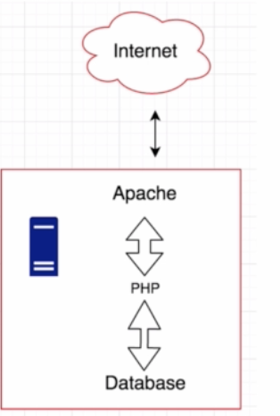
What is LAMP Stack?
LAMP – Linux, Apache, MySQL, PHP
Very popular stack
Most website run off a single server

Slide 16
MySQL Data types
Data types – database system stores and represents different types of data internally. Differ by the type of data you will be storing in these fields. Datatype will define what a column is inside database
MySQL supports basic categories:
Numeric – Numeric values
Character – Text strings
Binary – Binary data strings
Temporal – Time and date values
Json data types – Java Script Object Notation
Spatial data types – deals with places, define points on the map

Slide 17
Why datatypes are important?
Application to calculate GPA
Name | Total # of grade points | Total # of credit hours
Jane Smith | 12 | 34
Lana Wilson | 34 | 45
Jack Moore | forgot | ten
Andy Smith | null | I forgot
What do you think will happen when the application tries to perform calculations on row 3 and 4?

Slide 18
ABCs of MySQL Data types
Appropriate
Data needs to represented in the type that best fits the item it represents
Brief
Choose the data type that uses the least amount of storage space
Complete
Chose the data type that allocates enough room to store the largest possible value for the particular item

Slide 19
Numeric Data Types
Classes of numeric data types:
Integer: Whole Numbers
Floating-Point: Fractional Numbers
Fixed-point: Exact-value numbers
BIT: Bit-field values
Smallint/Tinyint/Mediumint/Decimal
There is more!

Slide 20
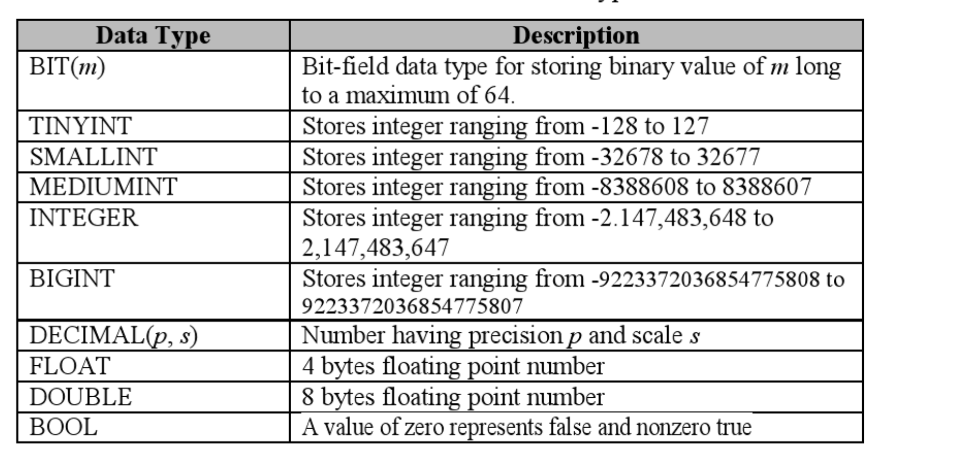
MySQL Numeric Data Types

Slide 21
Character String Data Types
A character string data type:
Represents a sequence of alphanumeric characters that belong to a given character set
Stores text
Is implemented in nearly every programming language
Belongs to one of the following classes:
Text: true, unstructured character string data types
Integer: Structured string types

Slide 22
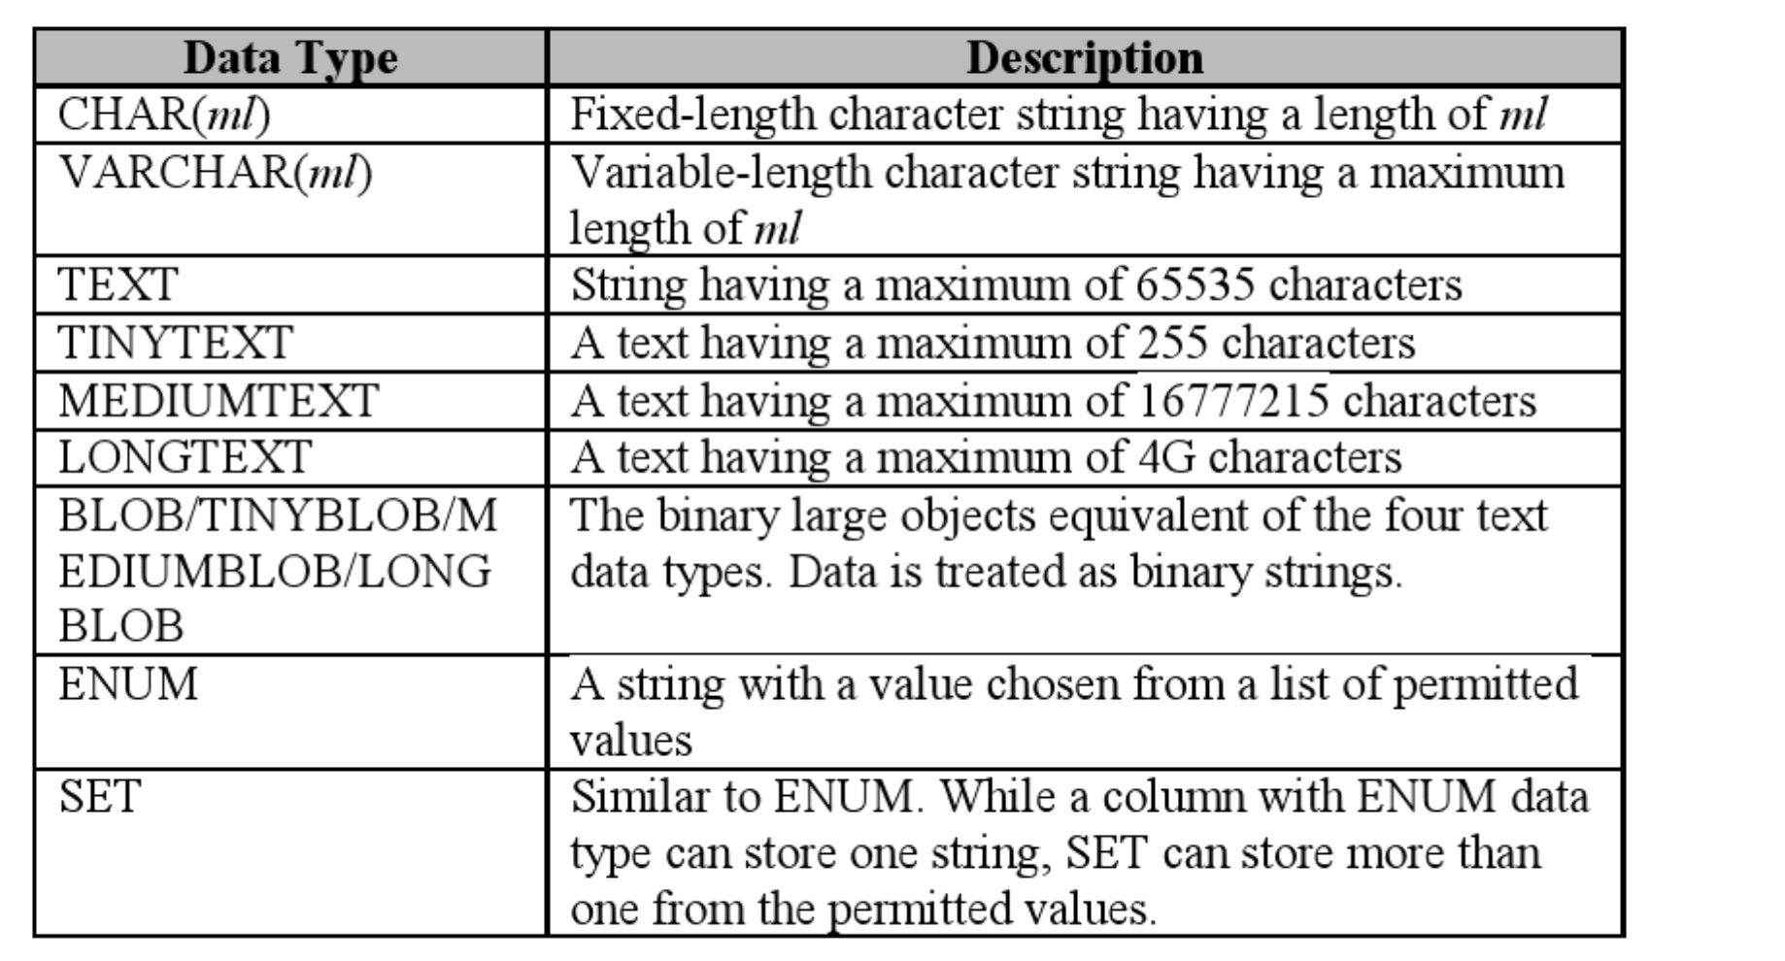
MySQL String Data Types

Slide 23
Binary String Data Types
Sequence of bytes
Binary digits (bits) in eights
Store binary values
Similar to CHAR and VARCHAR, except they contain binary strings instead of nonbinary
Classes of binary data types:
Binary – strings of both fixed and variable length
BLOB: Variable-length unstructured collection of binary data

Slide 24
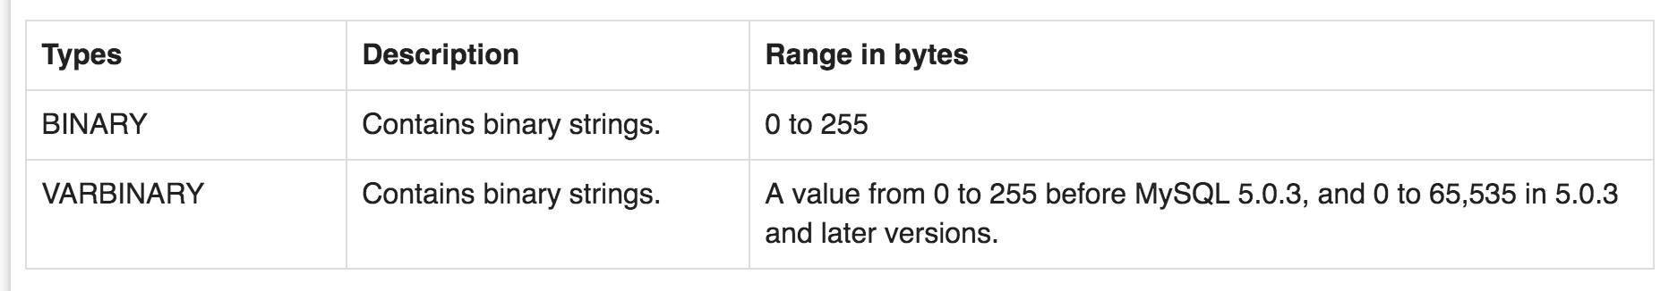
Binary String Data Types
Notes:
.

Slide 25
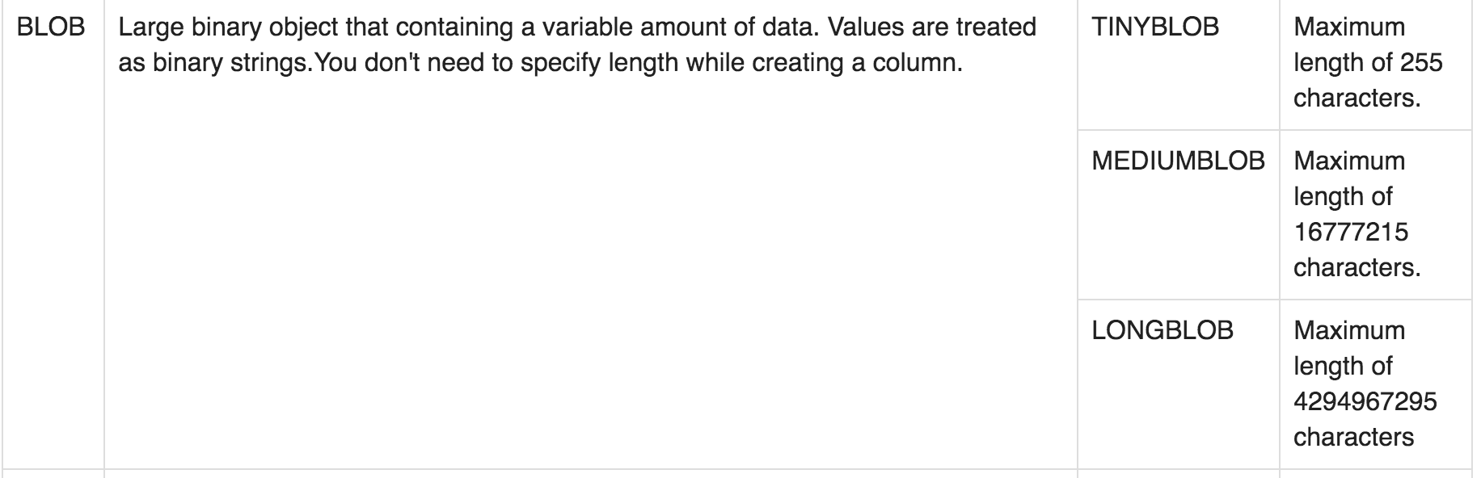
Binary String Data Types
Notes:
.

Slide 26
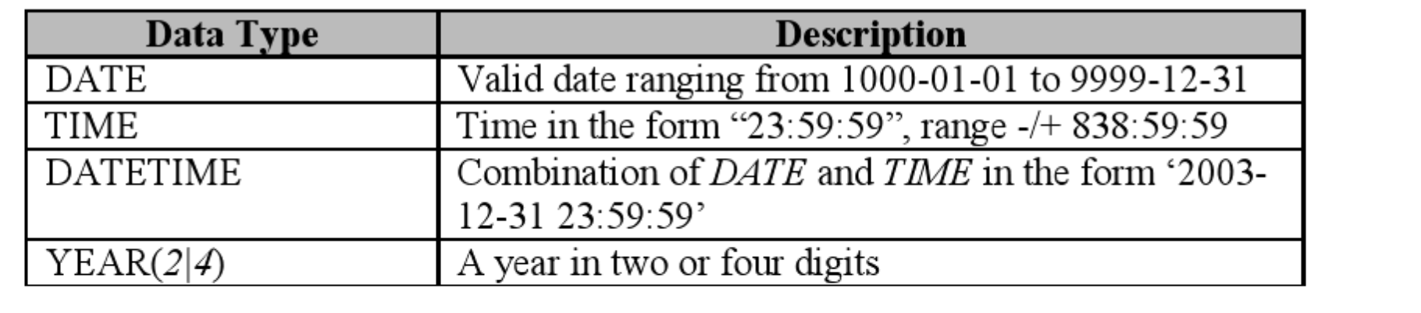
Temporal Data Types
Store date, time and year values

Slide 27
Basic Datatypes Used in Class
INT
Represents whole number
Max value 4294967295
VARCHAR
Variable-length string
Between 1 and 255 characters
DATE

Slide 28
More about Datatypes
Name | Total # of grade points | Total # of credit hours
Jane Smith | 12 | 34
Lana Wilson | 34 | 45
Jack Moore | forgot | ten
Andy Smith | null | I forgot
Name – varchar (100)
Total # of grade points – int
Total # of credit hours – int

Slide 29
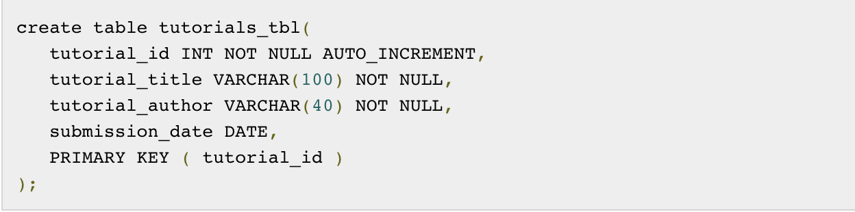
CREATING TABLES
https://dev.mysql.com/doc/refman/5.6/en/create-table.html

Slide 30
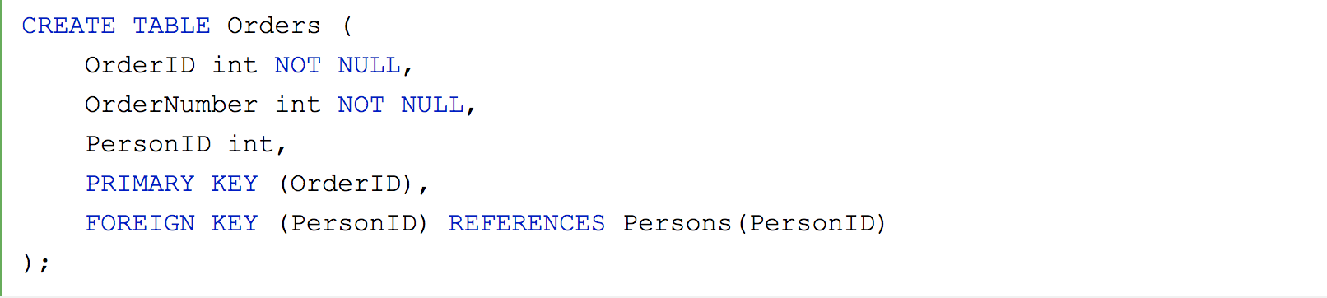
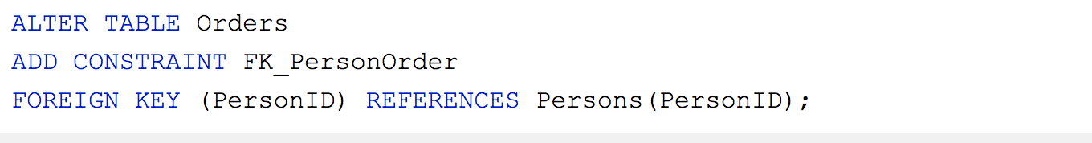

CREATING TABLES WITH FOREIGN KEYS

Slide 31
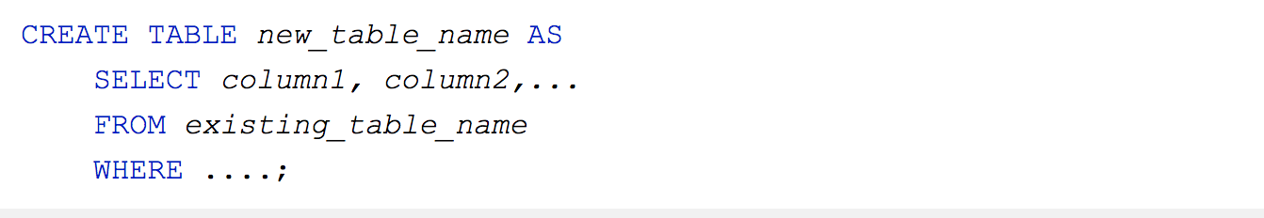
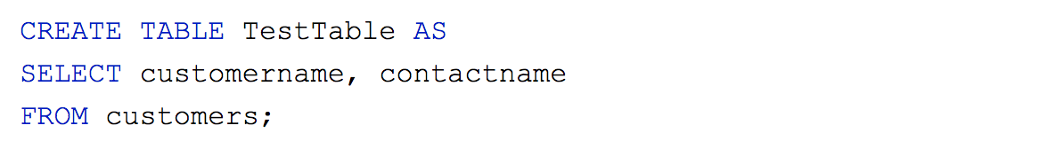
CREATING TABLES WITH SELECT

Slide 32
DROPPING TABLES

Slide 33
Basic Syntax - SELECT
Query – is a request for data from one or more tables
SELECT statement allows us to write basic queries
All queries use SELECT statement
SELECT statement has the following syntax:
SELECT column_names FROM table [WHERE condition];
Only SELECT and FROM clauses are mandatory
If your query does not have a WHERE clause you will get all the rows
SQL statements are not case sensitive
SELECT * FROM customers;
select * from Customers;

Slide 34
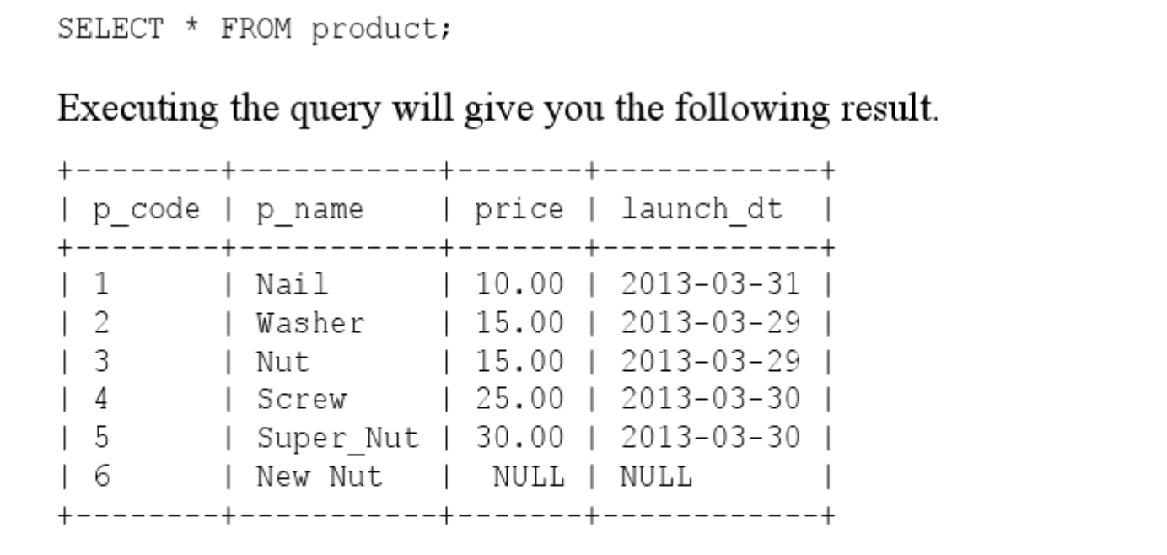
Basic Syntax - SELECT
Statement can have one or more clauses depending on the syntax.
FROM clause specifies the table(s) and WHERE the condition that must be met for each of the selected rows
The astrix is a special token that means return all available columns

Slide 35
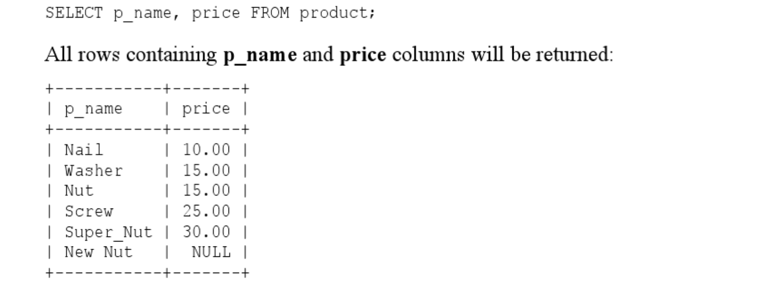
Selecting Specific Columns
To query specific columns, list the columns in the SELECT clause
Write the columns in the order you want to see them

Slide 36
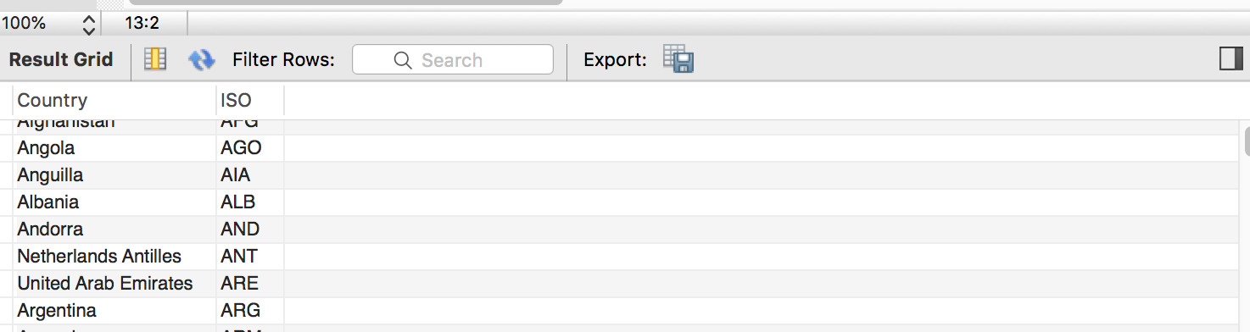
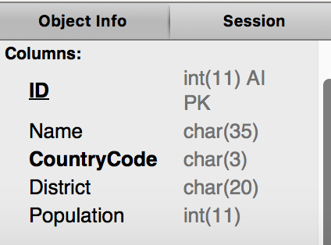
Selecting Specific Columns – Using Aliases
Can return different names in your column headers with AS clause
Column headers are names returned by the database interface
Can also omit AS – keep it, makes the code more readable
SELECT Name as Country, CountryCodes as ISO from city

Slide 37
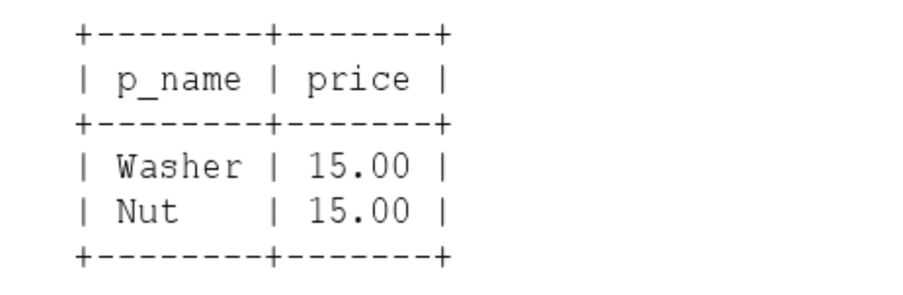
Filtering Rows with WHERE
To query specific rows, use WHERE clause
Below only rows whose price is 15 will be returned by the query:
SELECT p_name, price FROM product WHERE price = 15

Slide 38
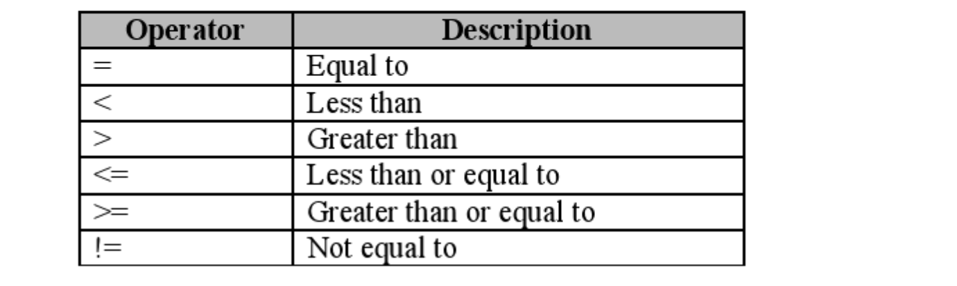
Filtering Rows with WHERE
To equal sign(=) in the WHERE condition is one of the comparison operators. Below are all of them:

Slide 39
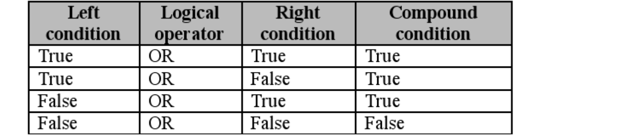
Compound Conditions
Using the AND and OR logical operator you can combine conditions to form a compound condition
Only rows satisfied by compound condition will be returned by the query
Below are rules for the OR logical operator

Slide 40
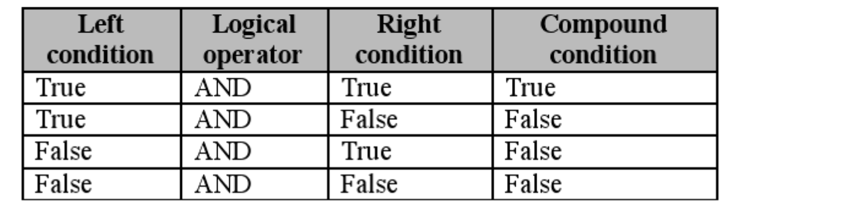
Compound Conditions
Below are rules for the AND logical operator

Slide 41
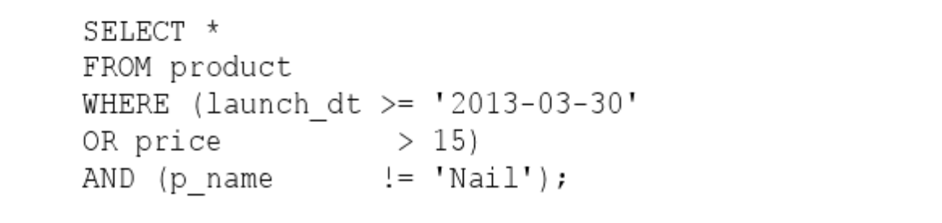
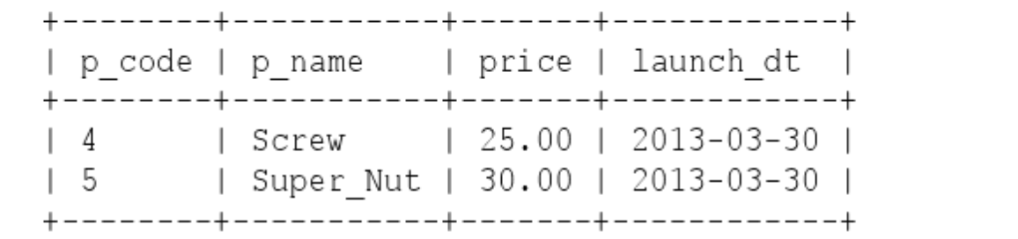
Compound Conditions
Below is the statement listing three conditions in its WHERE clause

Slide 42
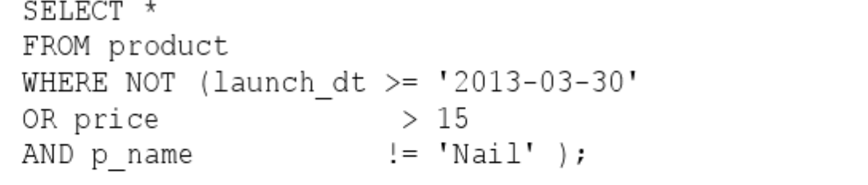
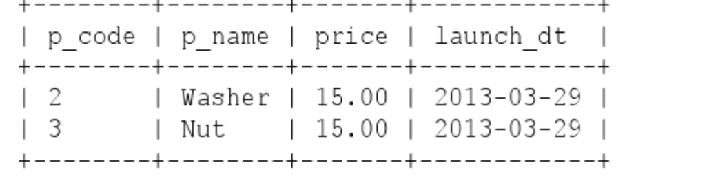
Filtering results with NOT, LIKE and IN and BETWEEN
You can use NOT to negate a condition and return rows that do not satisfy the condition:

Slide 43
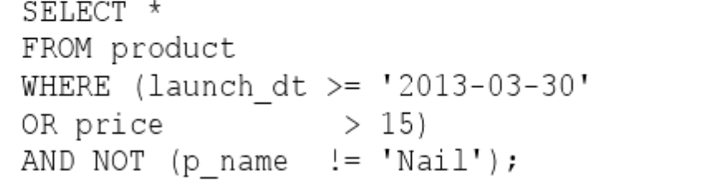
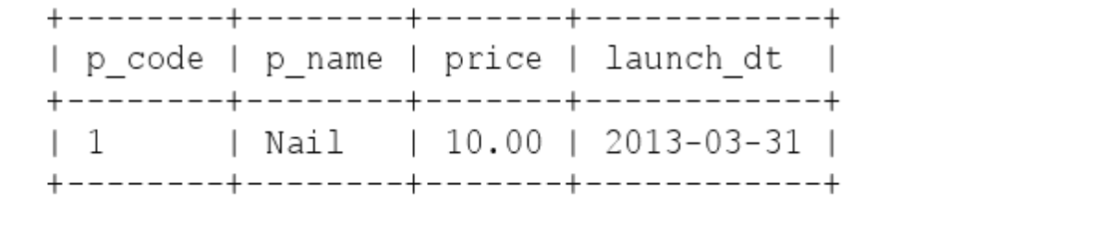
Filtering results with NOT, LIKE, IN and BETWEEN
Or we could have negated a specific condition only:

Slide 44
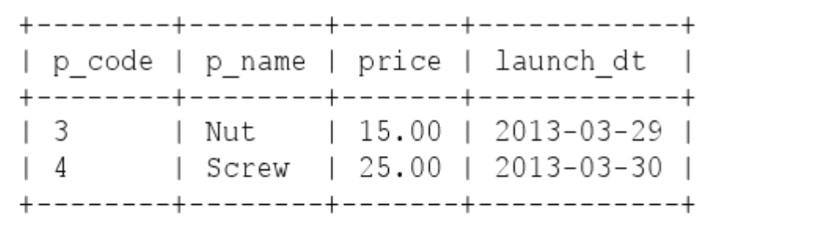
Filtering results with NOT, LIKE, IN and BETWEEN
LIKE allows you to specify an imprecise equality condition:
The wildcard character can be a percentage sign (%) to represent any number of characters or an underscore(_) to represent a single occurrence of any character.

Slide 45
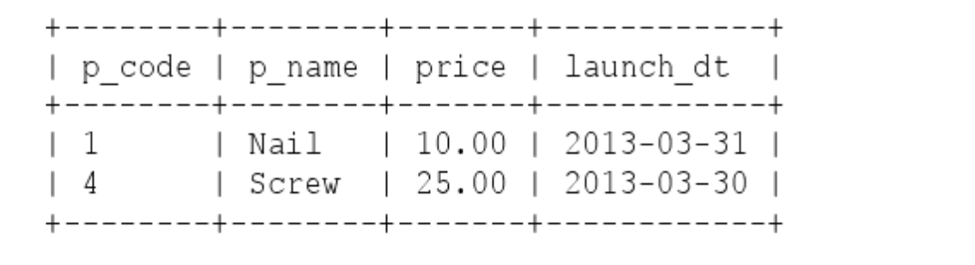
Filtering results with NOT, LIKE, IN and BETWEEN
The IN operator compares a column with a list of values:

Slide 46
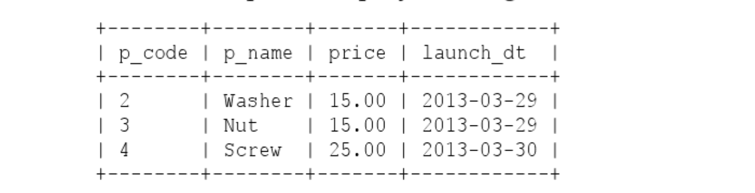
Filtering results with NOT, LIKE, IN and BETWEEN
The BETWEEN operator evaluates equality to any value within a range:

Slide 47
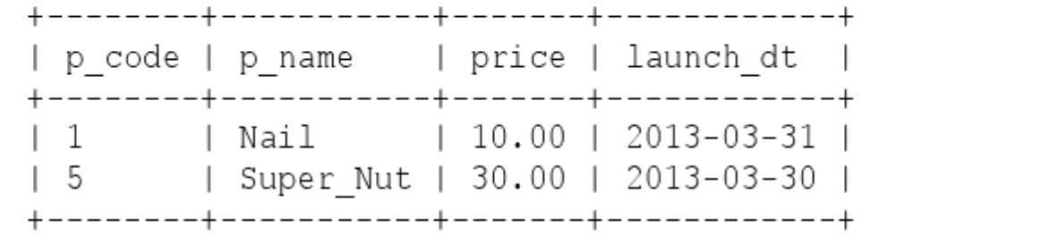
Combining the NOT operator
We can combine NOT with BETWEEN, IN, or LIKE to negate their conditions:

Slide 48
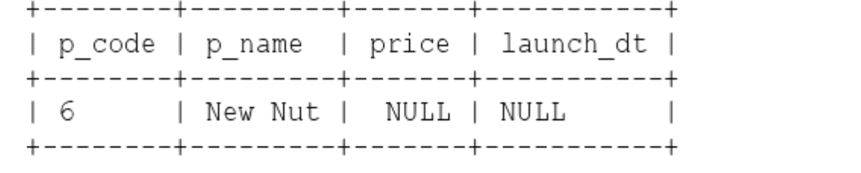
Filtering with NULL
We can manipulate NULLs as follows:

Slide 49
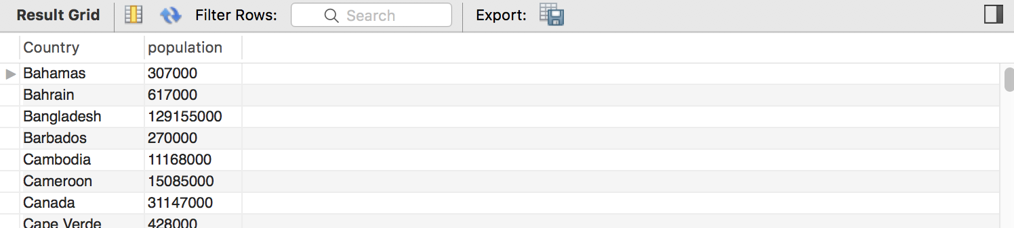
Filtering with Regular Expressions
Represent powerful pattern-matching tool, unlike LIKE
SELECT Name as Country, population from country where name like '_a%' order by name

Slide 50
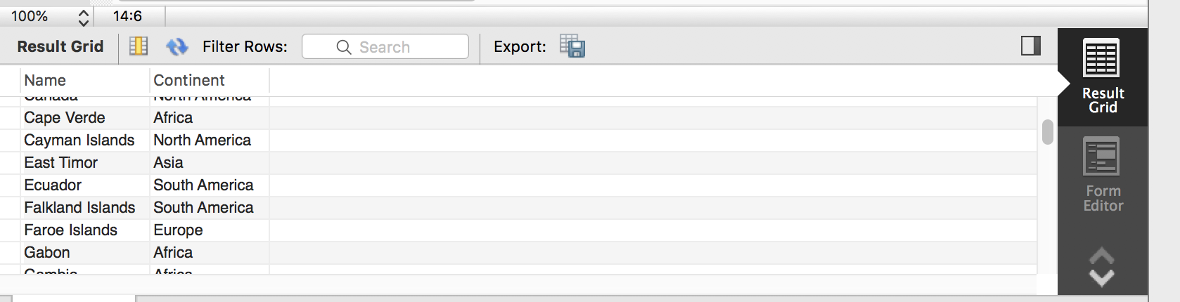
Filtering with Regular Expressions
What if we have more complex conditions?
Select Name, Continent from country where name like '_a%' OR name like '_b%' OR name lke '_c%' order by name

Slide 51
Sorting with ORDER BY
Use ORDER BY to provide better visualization of the output
ORDER BY must appear last in SELECT statement
You can order output rows by one of the following methods:
By one or more columns
In ascending or descending direction
By using the GROUP BY clause
By using UNION and other set operators

Slide 52
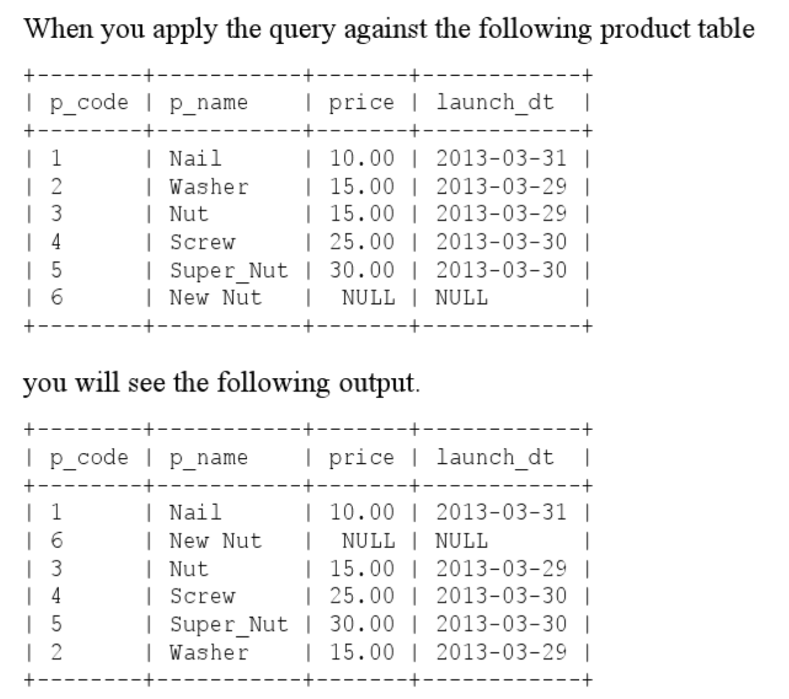
Sorting with ORDER BY
Order by one column:

Slide 53
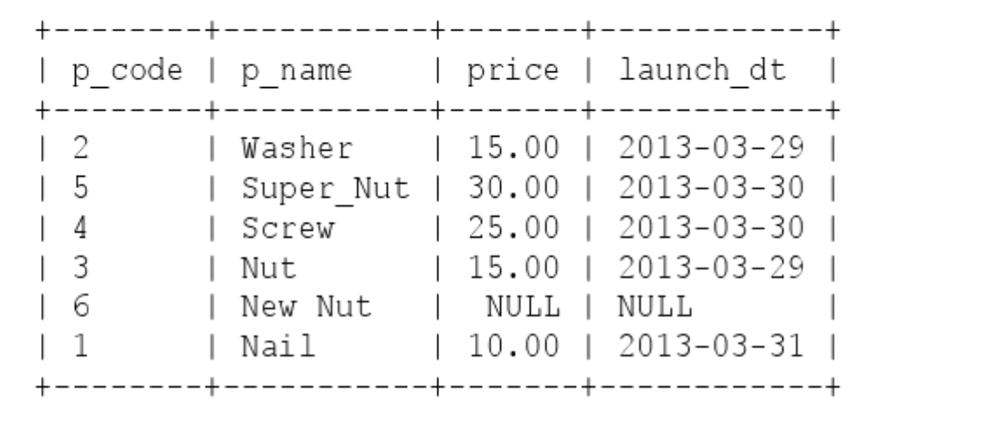
Sorting with ORDER BY – direction
Default direction is ascending. To order a column in descending direction use DESC reserved word:

Slide 54
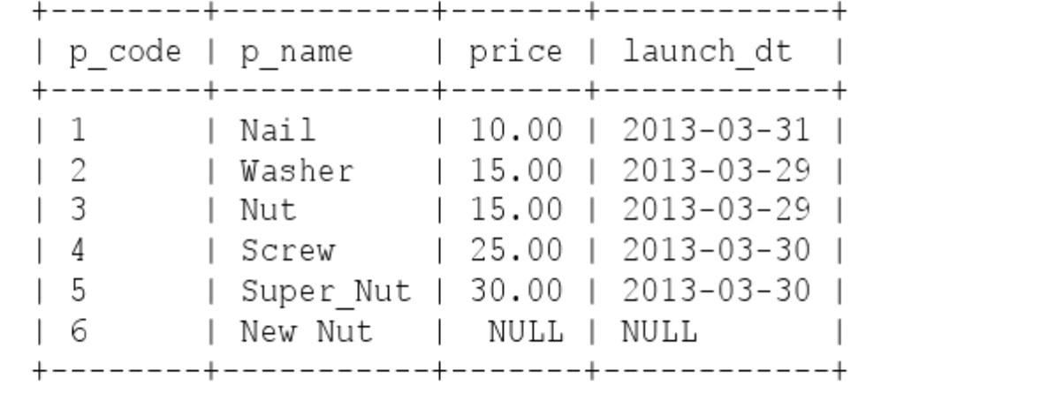
Sorting with ORDER BY – multiple columns
To order by more than one column, list the columns in the ORDER BY clause. Sequence of columns listed is important!
http://troels.arvin.dk/db/rdbms/#select-order_by

Slide 55
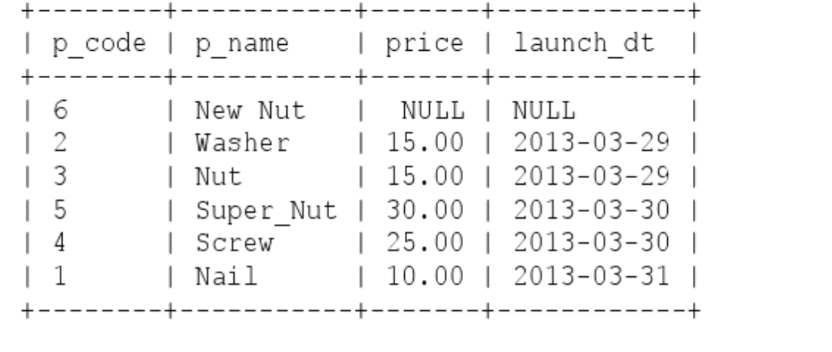
Different directions on different columns
You can apply different order directions on ordered columns too.

Slide 56
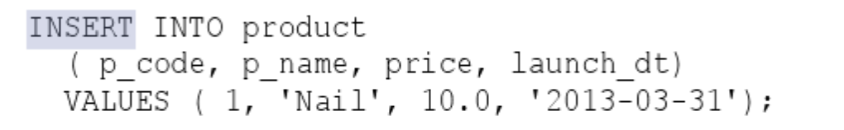
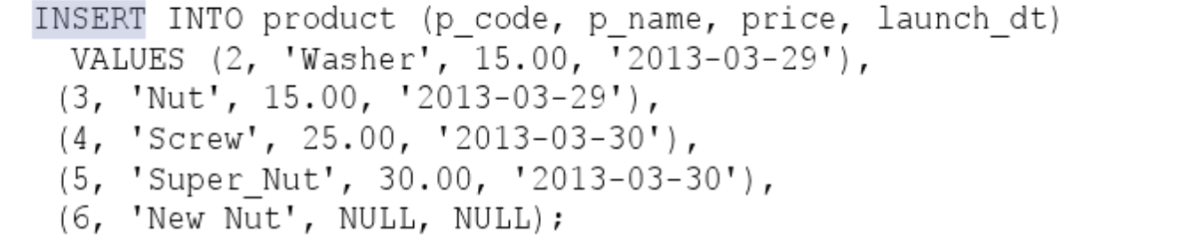
Adding data - INSERT
You can add data to a table using INSERT statement
Or can insert more than one row in an INSERT statement

Slide 57

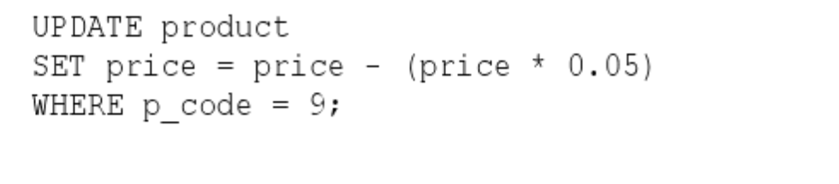
Update columns with UPDATE
You can use UPDATE statement to update one or more columns of existing data. You can update all or certain rows in a table
Specify which rows you want to update in WHERE clause

Slide 58

Delete rows with DELETE
To delete a row or multiple rows in a table
You can specify which rows to be deleted using WHERE
You cannot delete some of the columns in a row
DELETE deletes the whole row
To change content of specific column use UPDATE statement
If none of the rows meet the condition, nothing will be deleted

Slide 59
Database Transactions
A collection of data manipulation execution steps that are treated as a single unit of work
Use to group multiple statements
All or none of the steps succeed
Execute if all steps succeed
Cancel if steps have error or are not complete
Example – when making an online money transfer from one bank account to another:
Need to ensure that both of these operations are successful or neither is committed:
Money is taken from the sender’s account
The recipient’s account is credited by the same amount

Slide 60
ACID
Atomic
All statements execute successfully or are canceled as a unit and database is returned to previous state
Consistent
Database that is in a consistent state when a transaction beings, is left in a consistent state by a transaction. Operations do not violate integrity constraints
Isolated
One transaction does not affect another
Durable
All changes made by transaction that complete successfully are recorded properly in the database (i.e. written to disk)
Changes are not lost

Slide 61
Database Transactions
Transaction
A unit of work. One or more SQL operations. Typically DML statements that alter data. Can be one, can be hundreds
Commit
Indicates the end of transaction and tells database to make changes permanent. More efficient to do multiple operations as transactions.
Rollback
Revert all changes of the transaction
Save Point
Programatic point you can set, which allows you to rollback back of the transaction.

Slide 62
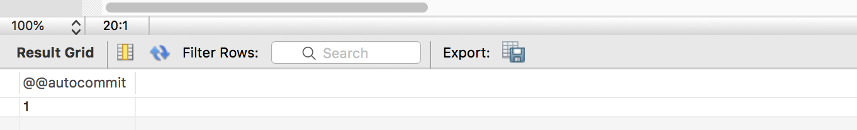
AUTOCOMMIT Mode
Determine how and when new transactions are started
AUTOCOMMIT mode is enabled by default:
Implicitly commits each statement as a transaction
Disable AUTOCOMMIT mode:
SET AUTOCOMMIT = 0;
Check AUTOCOMMIT mode:
SELECT @@AUTOCOMMIT;
0 – disabled
1 – enabled

Slide 63
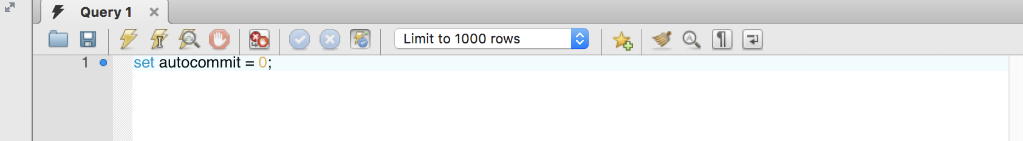

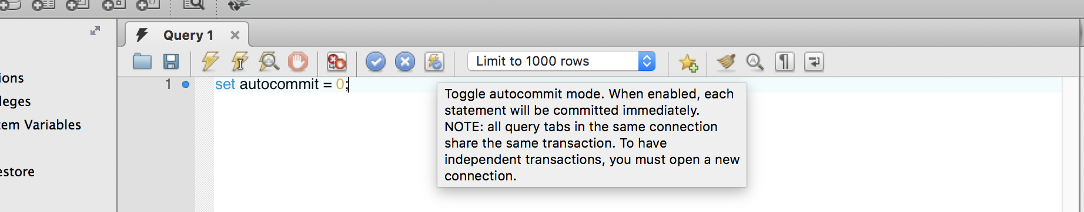
AUTOCOMMIT Mode
Set AUTOCOMMIT = 0 to disable or use icon

Slide 64
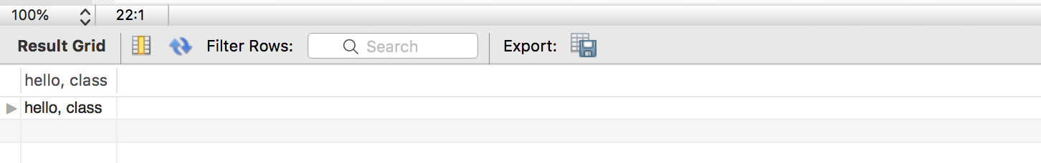
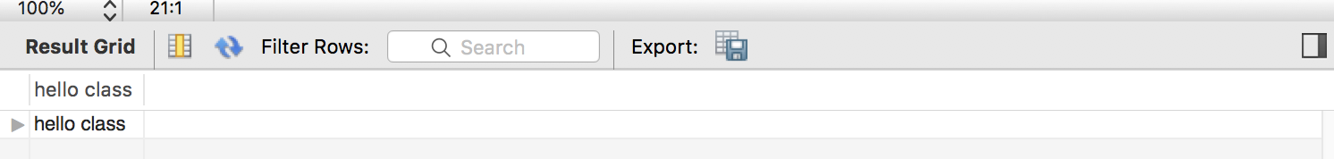
Literal Strings
Use literal values for many things – e.g. update rows with new values
Standard SQL
SELECT ‘hello, class’;

Slide 65
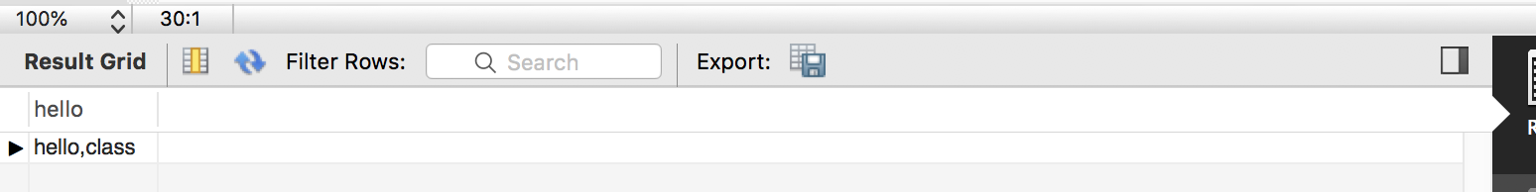
Literal Strings
We can concatenate strings in MySQL
SELECT 'hello' ',' 'class'

Slide 66
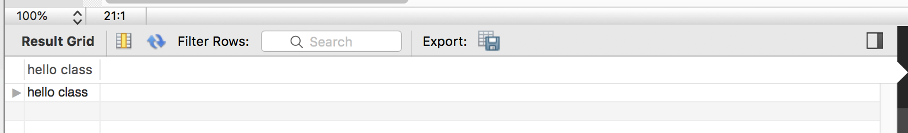
Literal Strings
We can concatenate strings in MySQL
SELECT 'hello' ',' 'class'
We can use double quotes
SELECT “hello class”

Slide 67
Getting Information about databases/tables
Listing the databases on a specific MySQL server:
Show databases;
Access a specific database:
Use [name of database];
To show currently selected database:
Select database();
Show tables in current database:
Show tables;
Show structure of a specific table:
Describe [name of table];

Slide 68
Sources
“SQL For MySQL: A Beginner’s Tutorial”
Oracle MySQL for Administrators

Slide 69
LAB

